Slide 1
Social Media
Engagement Analysis
PROBLEM STATEMENT & ANALYSIS • STAKEHOLDER BRIEFING
The problem we were asked to solve, and what the data says
Presented by: Preetvardhan Kushwaha
Date: 04 November 2026
1

Slide 2
The problem we set out to solve
PROBLEM STATEMENT
Problem statement
How can we use user activity data to recognize valuable users, re-engage inactive ones and guide content and campaign strategy?
Without structured analysis, rewards, content and campaigns rely on intuition rather than evidence.
01
02
03
04
Know the users
Find value and gaps
Guide content
Recommend
Understand activity across posts, likes, comments, follows and tags.
Identify valuable creators and users to re-engage.
Use hashtag and interaction patterns to shape campaigns.
Turn results into evidence-led actions.
2

Slide 3
The dataset at a glance
DATA OVERVIEW
100
257
8,782
Users
Photo posts
Likes
Distinct accounts
Available content records
Recorded photo likes
7,488
7,623
501
Comments
Follows
Tag links
Recorded comments
Rows in follows
Across 21 distinct tags
Cleaning checks
Why it matters
NULL and duplicate-key checks on users, photos, comments, likes and follows: no issues found.
These tables capture the core loop of creator activity, audience response and topic discovery.
3

Slide 4
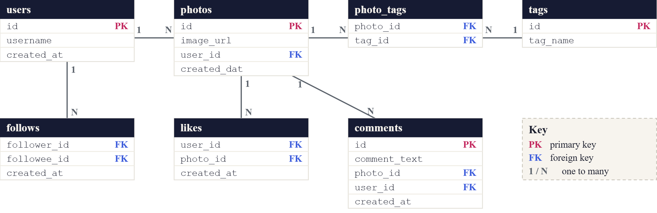
Seven tables connect users, content and engagement
DATABASE SCHEMA
Photos, comments and likes link to users through user_id; follows links users to users; photo_tags links photos to tags.
4

Slide 5
How we analysed the data
APPROACH
01
02
03
04
05
Inspect
Validate
Aggregate
Rank
Interpret
Review schema, keys and date fields.
Check nulls and duplicate keys.
GROUP BY, COUNT, AVG and CTEs at the right grain.
Compare users, tags and activity.
Visualize, state limits, recommend.
SQL features used
JOINs • LEFT JOIN • CTEs • UNION ALL • aggregate functions • RANK()
Counts are aggregated at the correct grain before joining, to avoid inflated totals.
5

Slide 6
No missing or duplicate usernames found
ANALYSIS 1 • DATA QUALITY
Rows flagged by each check
SQL query
100
-- NULL check
Users scanned
SELECT id, username, created_at
FROM users WHERE username IS NULL;
NULL usernames
0
-- duplicate check
SELECT username, COUNT(*) AS count
Duplicates
0
FROM users
GROUP BY username HAVING COUNT(*) > 1;
Both checks returned 0 rows across 100 users.
No cleaning was needed before analysis.
6

Slide 7
Users like more than they comment
ANALYSIS 2 • ACTIVITY VOLUME
Recorded interactions
Likes
8,782
Follows
7,623
Comments
7,488
Likes (8,782) exceed comments (7,488) by about 17%.
Each photo averages about 34 likes and 29 comments.
7,623 follow links across 100 users: about 76 per user.
7

Slide 8
Posts carry about two tags each
ANALYSIS 3 • TAGGING
Posts vs tag links
SQL query
Photo posts
257
SELECT ROUND(AVG(tag_count), 4) AS AverageTags
FROM (
501
SELECT p.id, COUNT(pt.tag_id) AS tag_count
Tag links
FROM photos p
LEFT JOIN photo_tags pt ON pt.photo_id = p.id
GROUP BY p.id
) AS per_photo;
501 tag links over 257 posts gives 1.9494 tags per post; untagged posts count as zero.
Tag count alone does not prove higher engagement.
8

Slide 9
Five creators stand out on received engagement
ANALYSIS 4 • CREATORS
Top 5 by likes + comments received
SQL score
■ likes ■ comments
-- activity score (excerpt)
Eveline95
749
COALESCE(r.likes_received, 0)
+ COALESCE(r.comments_received, 0)
Clint27
660
+ COALESCE(g.likes_given, 0)
Cesar93
646
+ COALESCE(g.comments_made, 0)
AS activity_score
Delfina_VonRueden68
558
Aurelie71
522
Eveline95 leads with a score of 749 (420 likes + 329 comments).
13 of the top 20 score exactly 514 from activity given: 257 likes and 257 comments each. Validate that unusual pattern before rewarding anyone.
9

Slide 10
13 of 100 users have no recorded activity
ANALYSIS 5 • RE-ENGAGEMENT
Users by activity status
SQL query
-- excerpt: no activity in 60 days
SELECT la.user_id, la.username, la.last_activity
■ 87 with activity ■ 13 inactive
FROM last_activity la
CROSS JOIN dataset_end de
WHERE la.last_activity IS NULL
OR la.last_activity <
DATE_SUB(de.max_date, INTERVAL 60 DAY)
ORDER BY la.last_activity, la.user_id;
All 13 have no photos, comments or likes on record.
The 60-day rule uses the dataset’s latest date, not today’s date.
10

Slide 11
Top hashtags perform almost identically
ANALYSIS 6 • HASHTAGS
Top 10 tags: avg likes per photo (photos)
SQL query
dreamy
35.75 (20)
WITH likes_per_photo AS (
beauty
34.95 (20)
SELECT photo_id, COUNT(*) AS like_count
FROM likes GROUP BY photo_id)
stunning
34.94 (16)
SELECT t.tag_name,
delicious
34.93 (15)
AVG(COALESCE(lp.like_count, 0)) AS avg_likes,
foodie
34.73 (11)
COUNT(DISTINCT pt.photo_id) AS total_photos
FROM tags t
happy
34.59 (22)
JOIN photo_tags pt ON pt.tag_id = t.id
hair
34.52 (23)
LEFT JOIN likes_per_photo lp
photography
34.5 (16)
ON lp.photo_id = pt.photo_id
GROUP BY t.id, t.tag_name
beach
34.48 (42)
ORDER BY avg_likes DESC LIMIT 10;
style
34.47 (17)
The top 10 averages sit within 1.3 likes of each other (34.47 to 35.75), so volume matters.
11

Slide 12
What the data cannot tell us
LIMITATIONS
Available
Not available
Handle with care
Users, photos, likes, comments, follows, tags and photo-tag links.
Demographics, video or reel labels, shares, ad impressions, clicks and conversions.
Activity is a proxy for value. Small samples can mislead, and correlation is not causation.
Good analysis states the boundary of its evidence.
12

Slide 13
Did we meet the objectives?
BACK TO THE PROBLEM
✓
✓
✓
✓
Know the users
Find value and gaps
Guide content
Recommend
100 users, 257 posts, 8,782 likes and 7,488 comments profiled.
Eveline95 leads with 749; 13 users show no activity.
Posts carry 1.9 tags; top tags average 34.5 to 35.8 likes.
Four evidence-led actions follow.
13

Slide 14
What the data tells us
CONCLUSION
Engagement
Creators
Re-engagement
Content
Users like more than they comment: 8,782 likes vs 7,488 comments.
Eveline95 leads received engagement with a score of 749.
13 of 100 users have no recorded activity.
Top 10 hashtags average 34.47 to 35.75 likes per photo.
Activity is healthy and the checked fields are clean. The next gains come from targeting and relevance, not raw volume.
14

Slide 15
What we recommend next
RECOMMENDATIONS
Recognize top creators
Test tag-led content
Win back inactive users
Close the data gaps
Why: Five creators lead received engagement (scores 522 to 749).
Why: Top tags average 34.5 to 35.8 likes; beach has the most volume (42 photos).
Why: 13 of 100 users have no recorded activity.
Why: No demographic, content-type or ad data is available.
Impact: More returning users.
Impact: Stronger retention and advocacy.
Impact: Measurable campaign learning.
Impact: Enables segmentation and ROI.
15

Slide 16
From insight to action
NEXT STEPS
Validate the unusual 514-score pattern.
Launch a tag-led content test.
Run a win-back campaign for inactive users.
Collect demographic and content-type data.
Better decisions start with the right question and end with evidence.
THANK YOU
16

